Slide 1

EMPLOYEE MANAGEMENT SYSTEM
Database-driven Console Application in Python
Sakshi Pandharipande
Emp ID:207009

Slide 2

AGENDA
INTRODUCTION
Tools and Technologies used
features of system
USER AUTHENTICATION
Input Validation
IMPLEMANTATION OUTPUT
conclusion

Slide 3

introduction

Slide 4
What is employee management system?
An Employee Management System (EMS) is a software application designed to facilitate the management of employee data and HR processes within an organization. Its primary purpose is to streamline and automate various tasks related to employee management, making it easier for HR departments and managers to handle personnel information.

Slide 5
Project Objectives
This project aims to develop a Console-Based Employee Management System that serves as an effective tool for managing employee records.
User-Friendly Interface: Develop a simple console-based application that allows users to interact seamlessly with the system through straightforward commands.
CRUD Operations: Implement core functionalities that enable users to:
Create: Add new employee records to the database.
Read: Retrieve and display employee information based on various parameters.
Update: Modify existing employee records when necessary.
Delete: Remove employee records securely and efficiently.
Data Integrity and Security: Ensure that the system maintains data accuracy and protects sensitive information through validation checks and proper error handling.
Scalability: Design the system with future enhancements in mind, allowing for the addition of more features as organizational needs evolve.

Slide 6
Importance of an Employee Management System
1. Streamlined Processes: Automating routine HR tasks reduces administrative burdens, allowing HR professionals to focus on strategic initiatives rather than manual data entry.
Automation of Routine Tasks: An EMS automates repetitive HR tasks such as employee onboarding, payroll processing, and leave management. This reduces the administrative burden on HR personnel, allowing them to focus on strategic initiatives rather than time-consuming manual processes.
Efficient Workflow: With automated workflows, tasks such as approvals for leave or expense claims are processed faster, improving overall operational efficiency.
2. Centralized Data Management: A centralized database ensures that all employee records are accessible in one location, improving data integrity and reducing the risk of data loss.
Single Source of Truth: An EMS provides a centralized database for all employee information, including personal details, job roles, performance reviews, and compensation. This reduces the chances of discrepancies and ensures that everyone in the organization is accessing the same data.
Improved Data Accessibility: HR personnel can quickly retrieve employee information, enabling faster decision-making and responses to inquiries.
3. Enhanced Decision-Making: Access to accurate and up-to-date employee information enables management to make informed decisions regarding hiring, promotions, and resource allocation.
Data-Driven Insights: By providing analytics and reporting features, an EMS allows organizations to analyze employee data for insights into productivity, performance trends, and workforce demographics. This information is invaluable for making informed decisions regarding hiring, promotions, and resource allocation.
Performance Tracking: With built-in performance management tools, managers can monitor employee performance and identify areas for improvement, supporting development and training initiatives.

Slide 7
Importance of an Employee Management System
4.Regulatory Compliance: Keeping accurate employee records is vital for compliance with labor laws and regulations. An effective EMS helps organizations stay compliant and avoid legal issues.
Maintaining Compliance: An EMS helps organizations adhere to labor laws and regulations by maintaining accurate and up-to-date employee records. Features such as tracking employee hours, managing leave entitlements, and storing compliance documents are crucial for legal adherence.
Audit Trail: Many EMS platforms provide audit trails that log changes to employee records, ensuring transparency and accountability in HR practices.
5.Cost Efficiency
Reduction of Administrative Costs: By streamlining HR processes and minimizing manual work, organizations can significantly reduce administrative costs associated with employee management.
Resource Optimization: Organizations can allocate resources more effectively, focusing on talent development and strategic initiatives rather than routine administrative tasks.
6.Future-Ready Workforce Management
Integration with Other Systems: Many EMS solutions can integrate with other business systems (like payroll, accounting, and CRM), providing a comprehensive view of organizational operations and enhancing overall efficiency.
Supporting Remote Work: With the rise of remote work, EMS platforms that are cloud-based allow HR teams to manage employees from anywhere, facilitating flexible work arrangements and improving employee satisfaction.

Slide 8

Key Functions of an Employee Management System:
Employee Records Management: Store comprehensive data about each employee, including personal information, job details, and employment history.
Attendance Tracking: Monitor employee attendance, including leaves, holidays, and absences.
Payroll Management: Automate payroll processes, ensuring accurate calculations of salaries, deductions, and benefits.
Performance Evaluation: Track employee performance and facilitate regular reviews and feedback.
Recruitment Management: Streamline the hiring process by managing job postings, applications, and candidate evaluations.
Reporting and Analytics: Generate reports for insights into employee performance, attendance trends, and workforce metrics.

Slide 9
Benefits of an Employee Management System:
Efficiency: Reduces manual paperwork and administrative tasks, allowing HR to focus on strategic initiatives.
Accuracy: Minimizes errors in employee data and payroll processing.
Accessibility: Centralizes employee information for easy access by authorized personnel.
Compliance: It helps make sure that the company follows labor laws and rules by keeping accurate employee records.

Slide 10
Overall System Architecture
The architecture can be divided into several key layers:
1. User Interface Layer
Console Interface: This layer is where users interact with the system through a command-line interface. Users can enter commands to perform various operations (e.g., add, view, update, delete employee records).
Input Handling: Accepts user inputs and validates them to ensure correct data formats.
2. Application Logic Layer
Business Logic: Contains the core functionalities of the system, processing user inputs and coordinating between the user interface and the database.
Function Modules:
Employee Management: Functions to create, read, update, and delete (CRUD) employee records.
Validation: Ensures that user inputs meet specified criteria (e.g., no empty fields, valid data types).
Error Handling: Manages exceptions and provides feedback to the user.
3. Database Layer
Database Management System (DBMS): MySQL will be used to store all employee-related data.
Database Schema:
Employees Table: Stores employee records.
User Table : Stores username and password

Slide 11
Tools and Technologies used
Technologies Behind the System

Slide 12
Tools:
Development Environment:
Software used :
1.For coding -Visual Studio Code
2.For Database:-
Mysql workbench
Mysql connector
Technologies
1.Programming Language:
The language used to build the application is (Python).
2.Database
MySQL :-
is a widely used open-source relational database management system (RDBMS) that uses Structured Query Language (SQL) for accessing and managing data.

Slide 13
Libraries Used:
Mysql.connect:-for database connections
re:- for regular expression to validate input
Getpass:-for secure password handling.
os.system for system commands(clearing the console).

Slide 14

Features of system
User Authentication
Registration and login system with password verification.
Employee Operations
Add Employee
Display Employee
Update Employee
Promote Employee
Remove Employee
Search Employee
Logout
Exit

Slide 15
User AUTHENTICATION
Registration Process
New users create a username and passoword
Passwords are confirmed before registration
User uniqueness is checked before addition to the database.
Login Process
Users provide credentials to access the system.
Credentails are validated against the database.

Slide 16
INPUT VALIDATION
Email validation
Uses regulation expression to ensure the email format is correct.
Phone Number Validation
Ensures the phone number starts with 7,8,9 and has in total 10 digits.

Slide 17
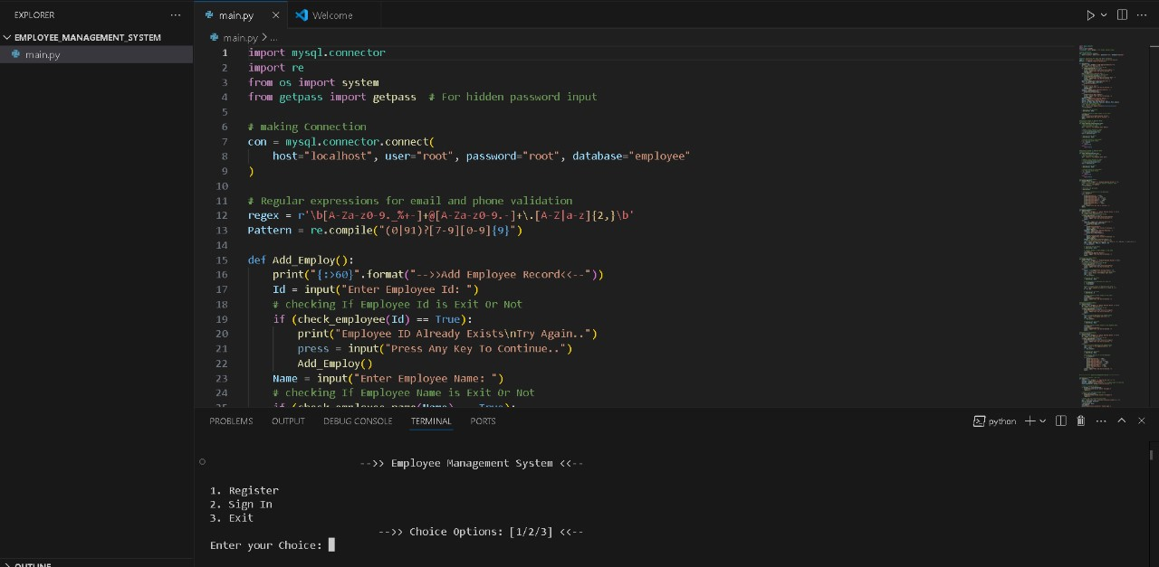
IMPLEMENTATION OUTPUT

Slide 18
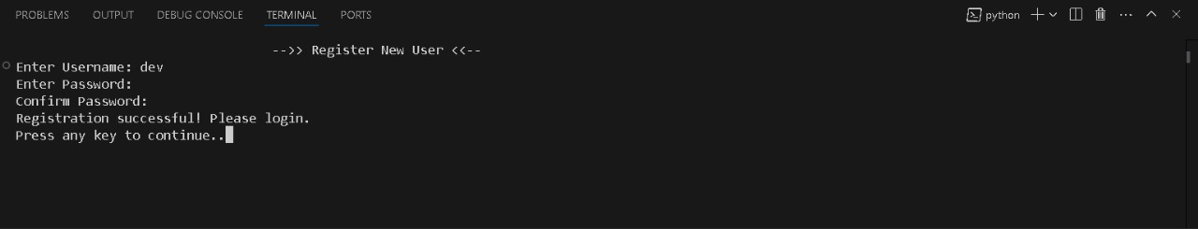
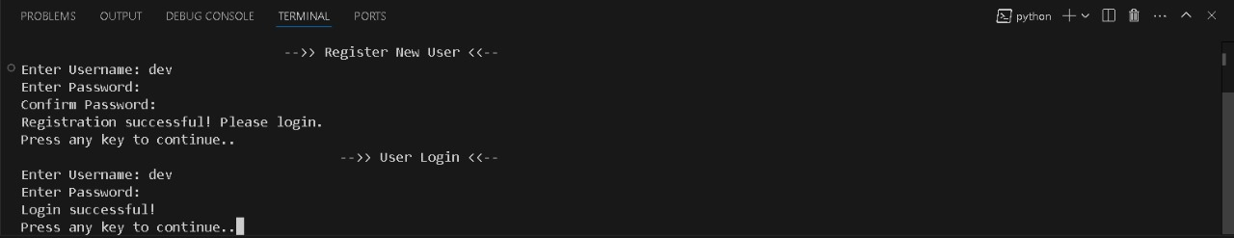
IMPLEMENTATION OUTPUT

Slide 19
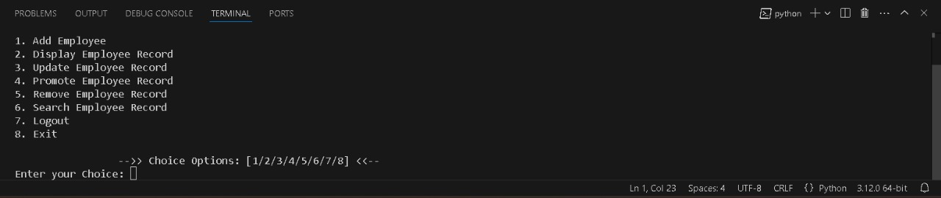
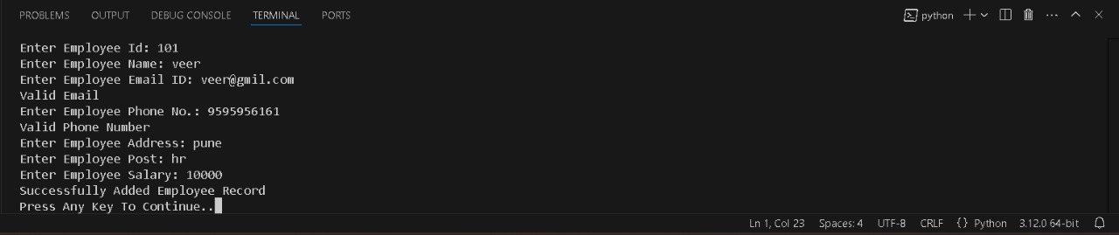

Slide 20
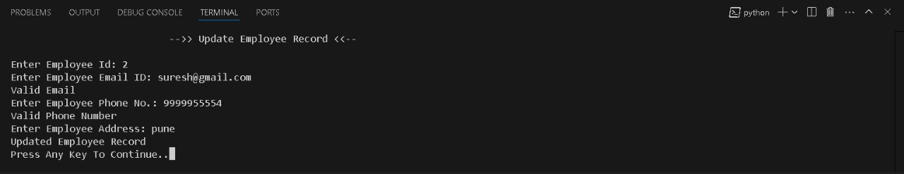
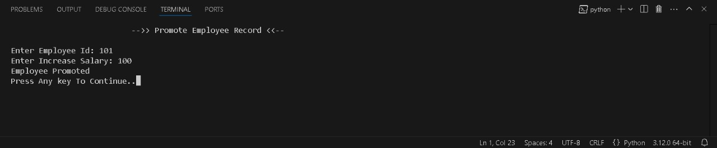

Slide 21
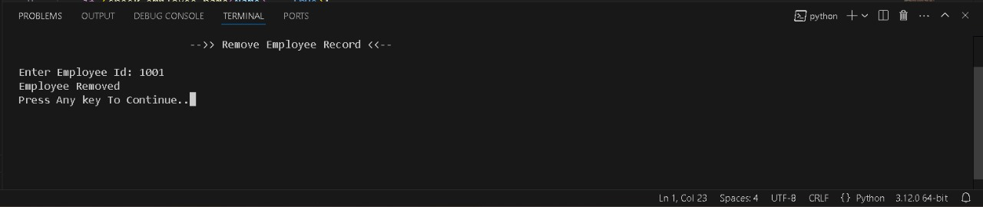
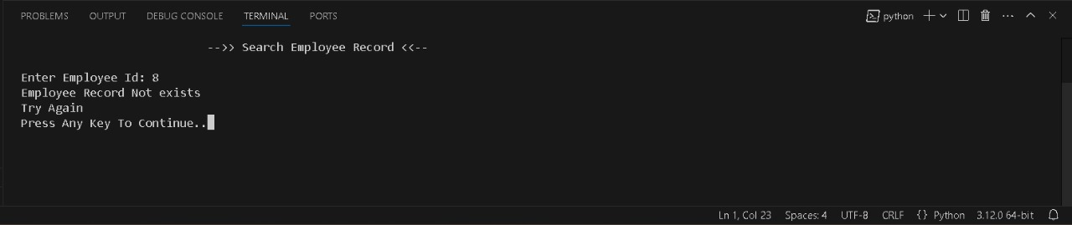

Slide 22

THANK YOU

